Slide 1
MULTI-DIMENSIONAL ARRAYS

Slide 2
Multi-Dimensional array Declaration
A multidimensional array can be thought of as an Array of Arrays.
Syntax for declaration :
int arr[2][3]; // Two dimensional Array
int arr[2][3][3]; // Three dimensional Array

Slide 3
2 D Arrays
The basic form of declaring 2d arrays is :
data_type name_of_array[x][y];
Where x and y is the size if the array
eg : int arr[2][3]={1,2,3,4,5,6};

Slide 4
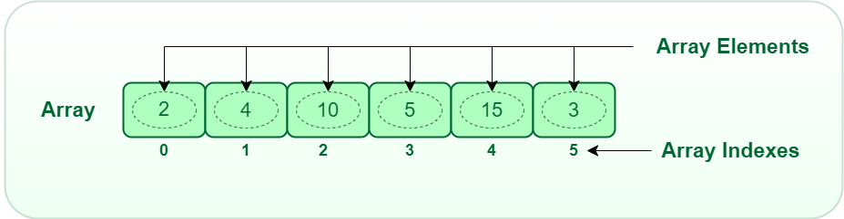
1D Array

Slide 5
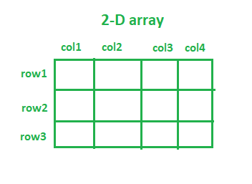

Slide 6
2D Array Declaration and initialisation
Method 1
Int arr[2][3]={1,2,3,4,5,6};
Method 2
Int arr[2][3] = {{1,2,3},{4,5,6}};

Slide 7
How to access a 2D array
Int arr[2][3] = {{1,2,3},{4,5,6}};
for( i=0 ; i < 2 ; i++)
{
  for ( j=0; j<3; j++)
  {
    printf(‘%d “, a[i][j]);
  }
}

Slide 8
Challenge 1
Create a 2 D array that can store the sequence of numbers from 1 to 18

Slide 9
3D Array
3D array declaration syntax
int arr[2][3][3];
This means give me 2 blocks of memory and let each block have 3 rows and 3 columns
3D array indexing
arr[0][0][2]

Slide 10
3D Array Initialization
Method 1
Int arr[2][2][3]={1,2,3,4,5,6,7,8,9,12};
Method 2
Int arr[2][2][3]={ {1,2,3},{4,5,6}},
{7,8,9},{10,11,12}},
};

Slide 11
How to access 3 D arrays
for( i=0 ; i < 2 ; i++)
{
for ( j=0; j<3; j++)
{
for ( k=0; k<3; k++)
{
printf(‘%d “, a[ i ][ j ][ k] );
}
}
}

Slide 12
Challenge
Create a 3D array that can print the number 1 to 30

Slide 13
Variable Length arrays
Means the length/size of array is determined by the user
Advantages:
It makes the array dynamic

